Slide 1
GYBITG
Get Your Butt In The Gym!
App Demo

Slide 2
MVP
The MVP will allow the coach user to quickly view and search through a list of athletes with the help of filters to better find specific athletes that fill the positions on the coaches team and then select the athletes page. The coach can also quickly view a list of athletes they have followed. The coach can then select athlete profiles to view recent videos from the athletes.

Slide 3
User Stories
User Story: Basic Search
User and Goal: As a Coach user I want to be able to find quickly search for an athlete by name or high school.
Acceptance Criteria: I am presented with the athletes I have searched for.
User Story: Advanced Athlete Search
User and Goal: Coach user will be able use advanced search criteria for specific players based on a list of things.
Acceptance Criteria: Coach can view their search results based on the advanced search.
User Story: Results Page for Athlete search
User and Goal: Coach user is able to view the results of their search.
Acceptance Criteria: Coach user sees a Results page displaying athletes matching their search with basic information.

Slide 4
Accomplishing the MVP
Basic search functional
Advanced search functional
This includes searching for position and High School Grad date
Registration for coach and Athletes
Data saves in database correctly
Position as a dropdown menu
Authorization
User and Coach login
Data Validation

Slide 5
Athletes For Demo
Kevin James
Point Guard
Juanita
James Freed
06/10/2019
Ben Hello
Shooting Guard
Bothell
Mary Watkins
06/12/2019
Keith Rutger
Point Guard
Lake Washington
Alex Sparks
03/11/2020
Daniel Watkins
Small Forward
Bothell
Mary Watkins
06/12/2019

Slide 6
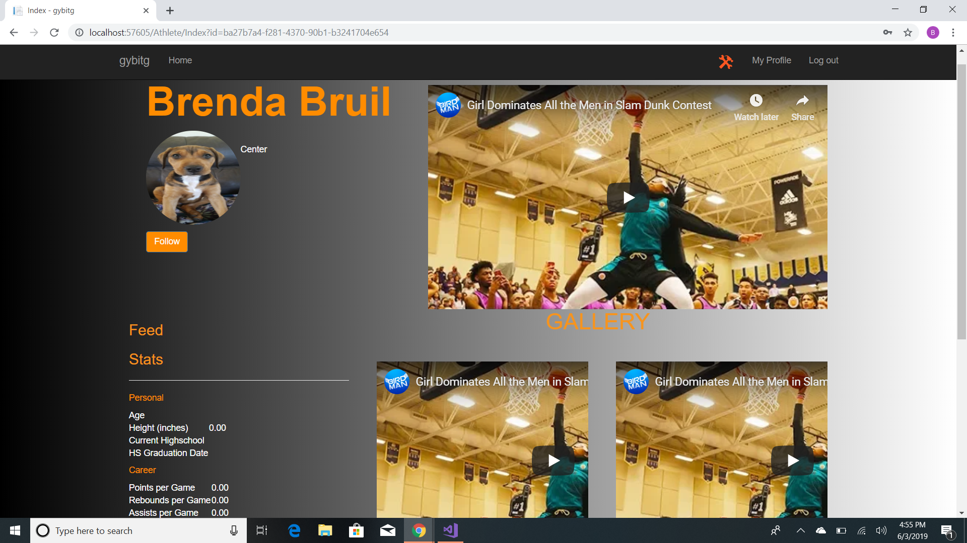

Slide 7
Code Struggles
Alex- Calendars
Keith- Input Verification Allowance
Kevin- Log in/Log out status
Daniel- Search Logic
Adam- Starting off

Slide 8
Next Steps
Being able to follow an athlete
Coach private facing profile with list of athletes followed
Public facing athlete profile page
Coach verification
Feature enhancements

Slide 9
Any Questions?

Slide 10
FIN

